Slide 1
Employee Reviews On Top Listed MNC’s Helpfull For Future Generations On Their Carrier Goals
Mynampati Prudvi

Slide 2

Introduction
Employee reviews on MNC such as Google, Amazon, Facebook, Apple, Microsoft, and Netflix in various aspects of organisation activities and exposure like carrier-opportunities,comp-benefit,culture-values,senior-management,work-balance which also include the individual employee ratings adding advantage to the new employee.

Slide 3




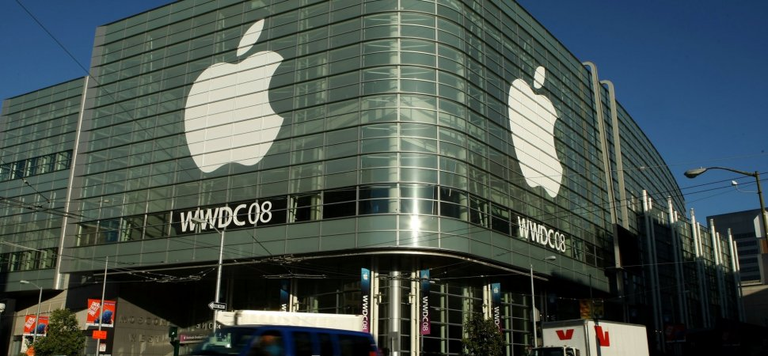


Slide 4
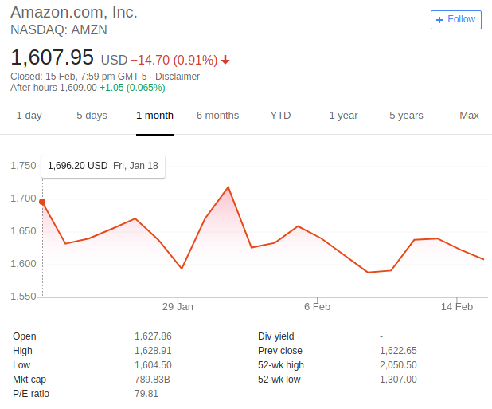
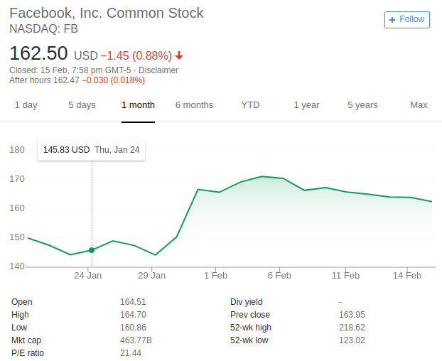
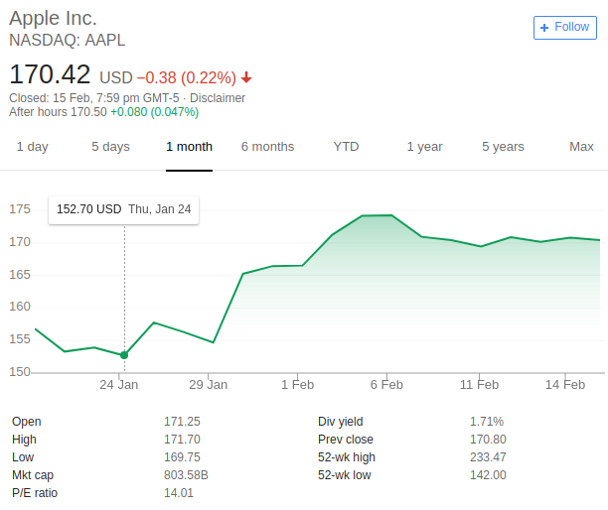
$ 1 trillion Net Value
5th JULY 1994 ESTB
$508 Billion Net Value
Feb 2004 ESTB
$852 Billion Net Value
1st APRIL 1976 ESTB

Slide 5
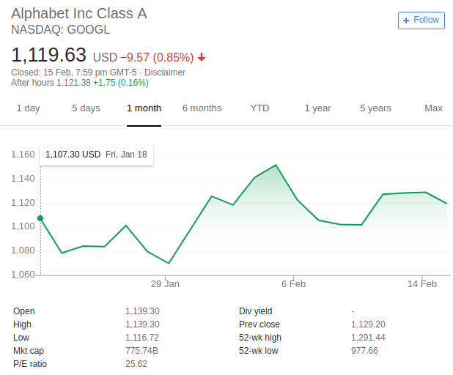
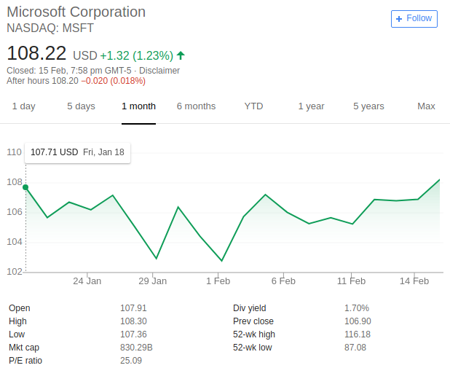
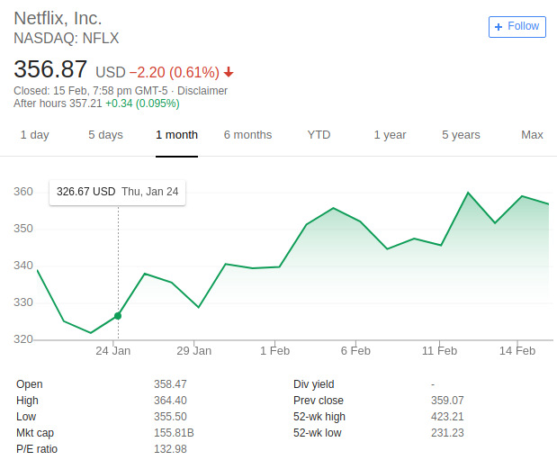
Near to $1 trillion Net Value 4 September 1998 ESTB
$753 billion Net Value
4 April 1975 ESTB
$3.7 billion Net Value
29 August 1997 ESTB

Slide 6
Factors driving an employee to shift from one MNC to another
(Few things to look into)

Slide 7
Consider how each job aligns with your long-term career goals
Is current job matching to your career goal?
Does one job have more opportunities for growth than the other?
which kind of job gives me a challenge?
Which job offers me the chance to learn new skills?

Slide 8

“Why do you want to work for this company?”
For example,This year, Google topped Fortune’s list of the 100 best companies to work for in the USA for the seventh time in a decade.
Not every firm has the celebrity profile or resources of a Google or a Facebook, but there are some valuable lessons to learn about what they do well.

Slide 9
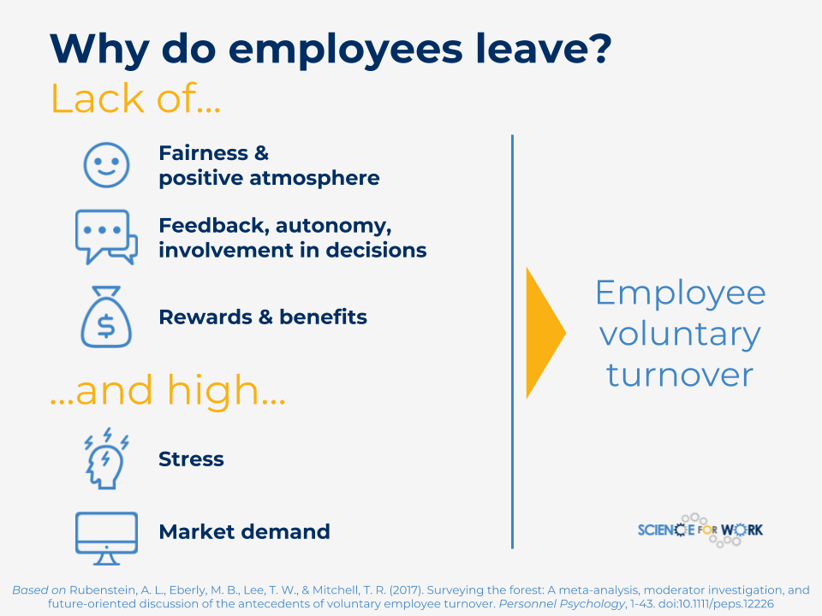
1. Staff turnover: what can it tell you?
Bayt.com carried out a report with YouGov in April 2015, which found that of 5,774 respondents, 43% expected to leave their jobs within two years.
The reason might me salaries or lack of career growth opportunities.
This reflects the reason behind people switching as something more fundamental and long term is missing.
Chances are that job turnover in your firm is already high, so if you’re looking for somewhere to settle, a shrewd approach may be to look at what the firm is doing about it.

Slide 10
2. How is the company performing?
Before we get into this, it’s worth taking a moment to think about what that question really means. At first glance, it’s about the company’s financial fortunes– a healthy balance sheet bodes well for your own future with the firm.
There may be plenty of ways to keep a company performance on top in market., whether it’s following them on LinkedIn or just targeting news stories about them.
Payscale also found that employee retention was the number one priority of these top performers. As “satisfied employees are the most important assets a company can have.
They are more productive, motivated and loyal, which improves an organization’s chances of success.”

Slide 11


Slide 12
3. Work-life balance – what do they expect from you?
It’s important to find out everything possible in terms of how the company and in particular your new manager approaches their relationship with employees.
For this, remember the power of social networking– research whether any of your connections work for the firm, or perhaps more tellingly, have worked there in the past. Find out about the role, the team and the manager.

Slide 13
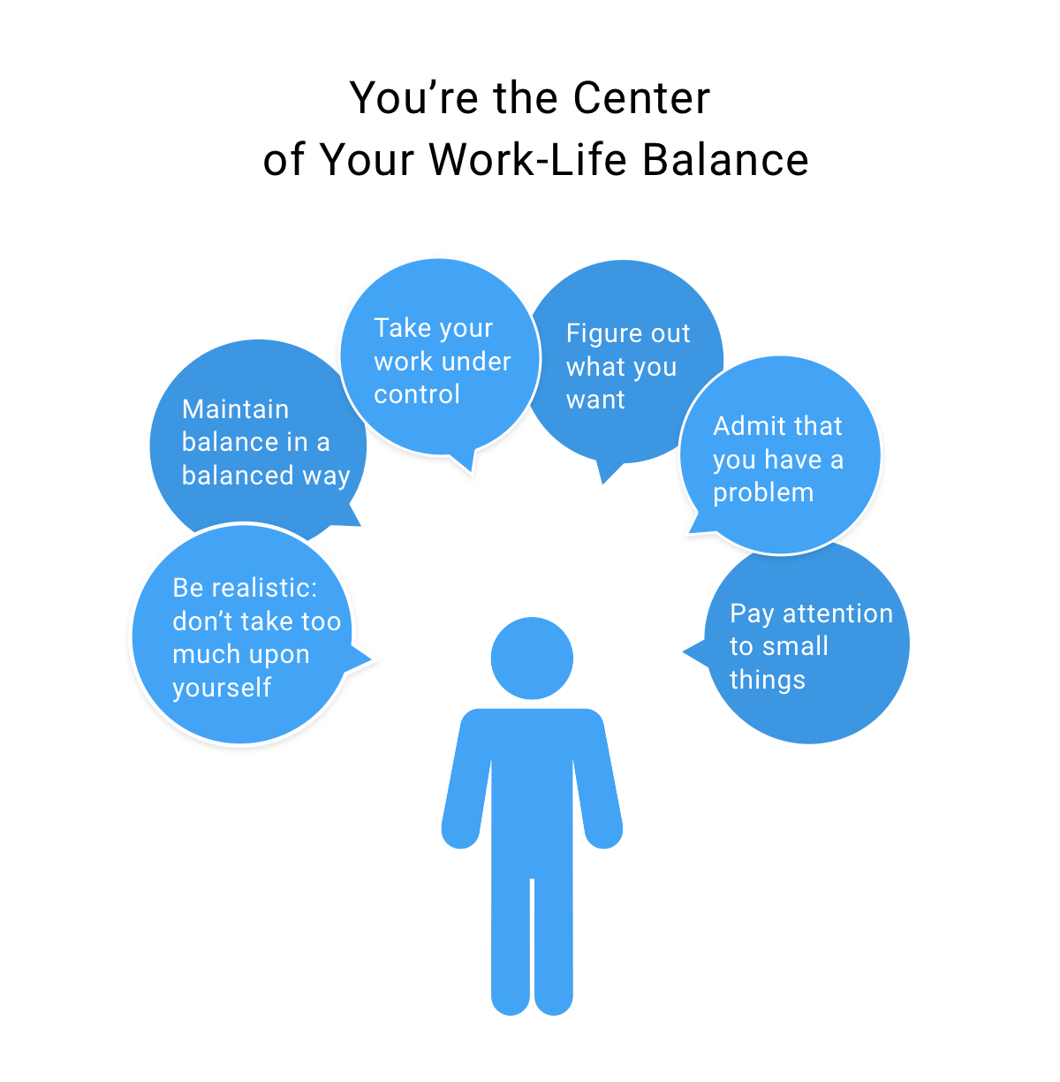

Slide 14

4. Do you fit in?
“Find a job you love and you’ll never work a day in your life.” But finding the right role for you is as much about the company and its culture, vision and values as it is about the job on paper.
Employers looking to hire someone who not only fulfills the technical requirements, but has the qualities to fit into the company culture.
It’s about asking questions on work style, what good results look like, how they solve problems, and how they go about building relationships

Slide 15

5. Can you learn something?
If someone offers you an amazing opportunity and you’re not sure you can do it, say yes– then learn how to do it later.
career progression doesn't mean designation with more responsibility. Take it as an opportunity to develop your skill set.

Slide 16
Carrier target to achieve
I am interested in learning more about (something this job includes), and this job provides an opportunity to leverage my current areas of expertise and increase my skills
Your focus here is on (something that you like), and I really enjoy doing (whatever that is). So, I expect to increase my enjoyment of my work when I am able to focus more on (that aspect of the job).
I enjoy working as part of a team and am looking for an opportunity to work on an interesting project. This job is part of a team working on a fascinating project, and I would love to join in this work

Slide 17
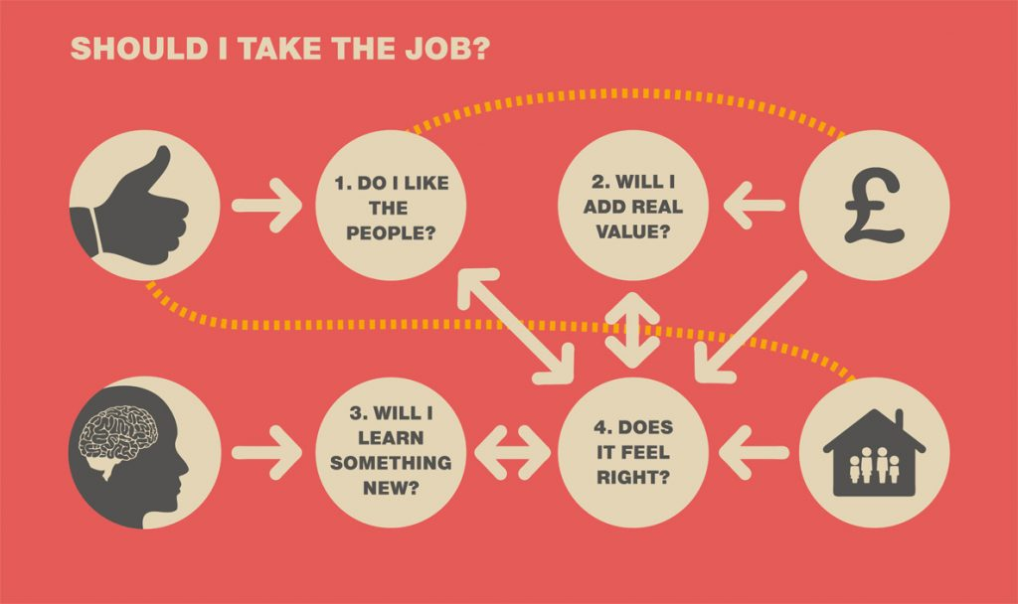

Slide 18
Data Visualization Reports Of the Companies prefer to join? (derived from the Ratings given By Employees
From Glassdoor Data from Kaggle)

Slide 19
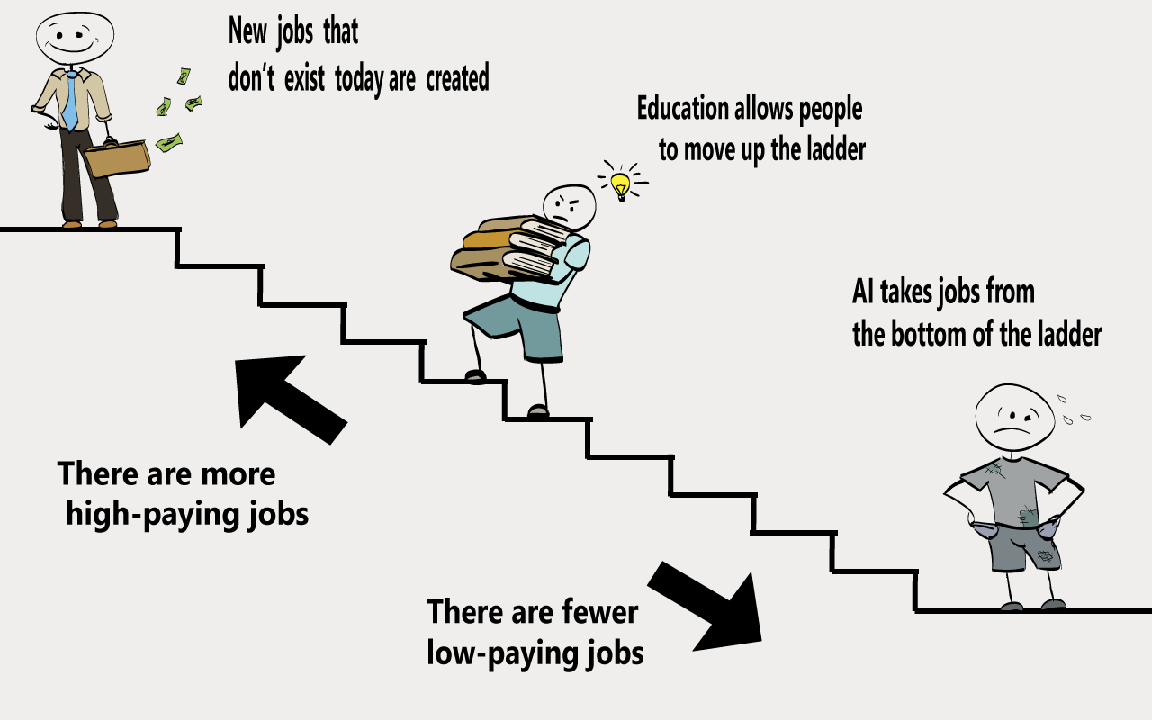
Education is the key factor for a step in but the path which which we choose make the situations change in life.

Slide 20
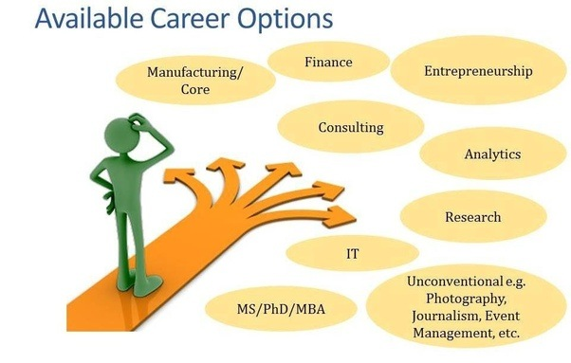
Select the carrier path which enables to work with interest

Slide 21
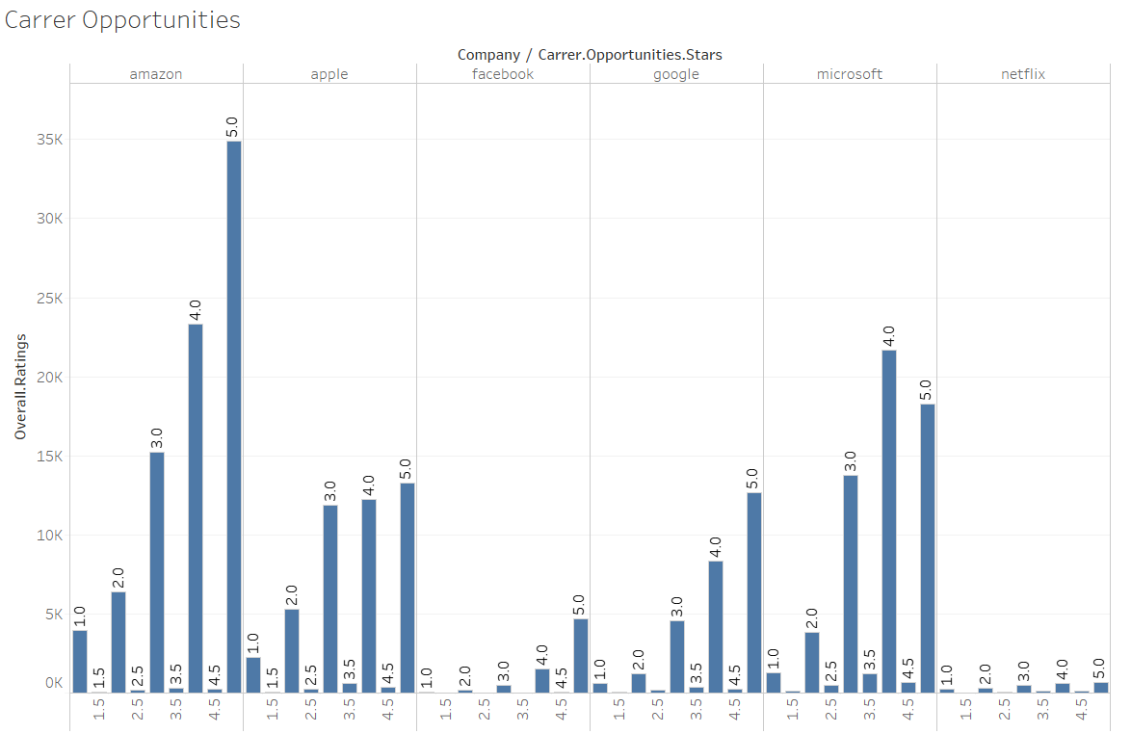
Selecting the organization with carrier opportunity based on employee ratings

Slide 22
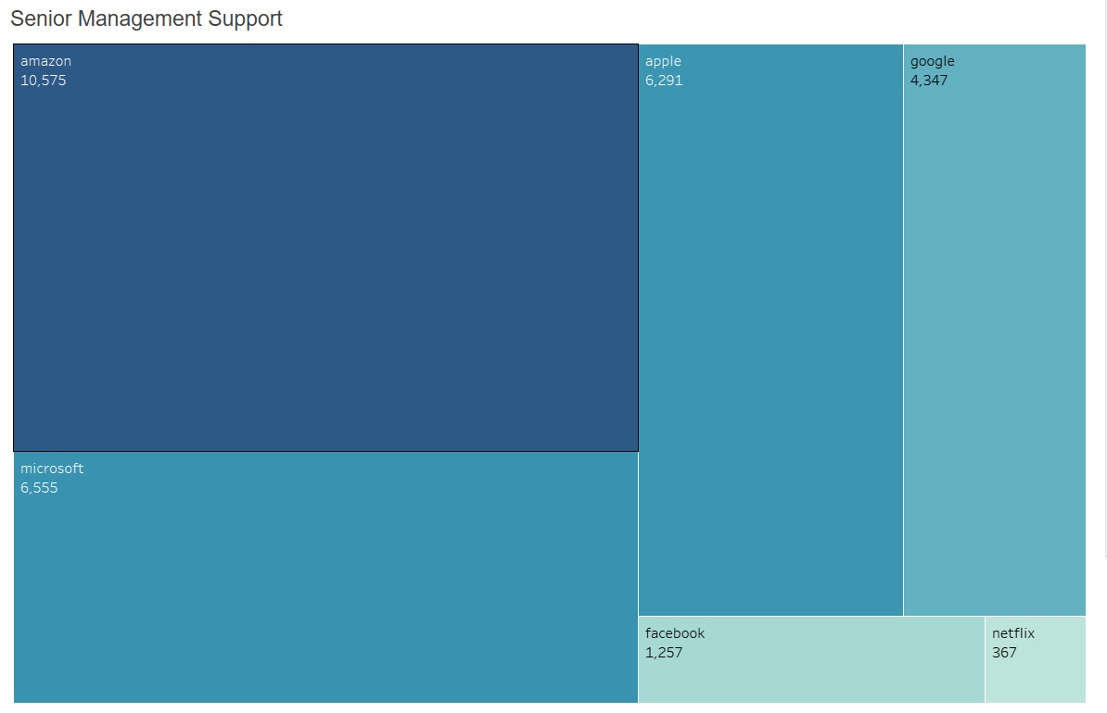
Selecting the company with senior management support based on employee ratings preferabily gggreatgreatgreate greater than 4

Slide 23
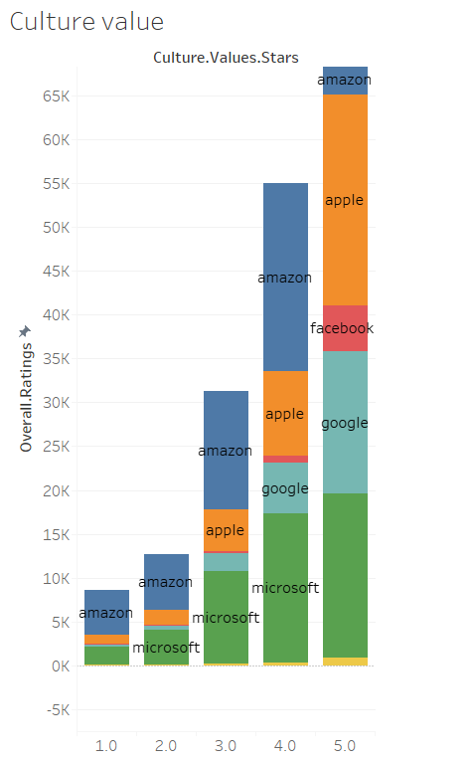
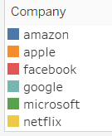
Selecting the company with culture value based on employee ratings

Slide 24
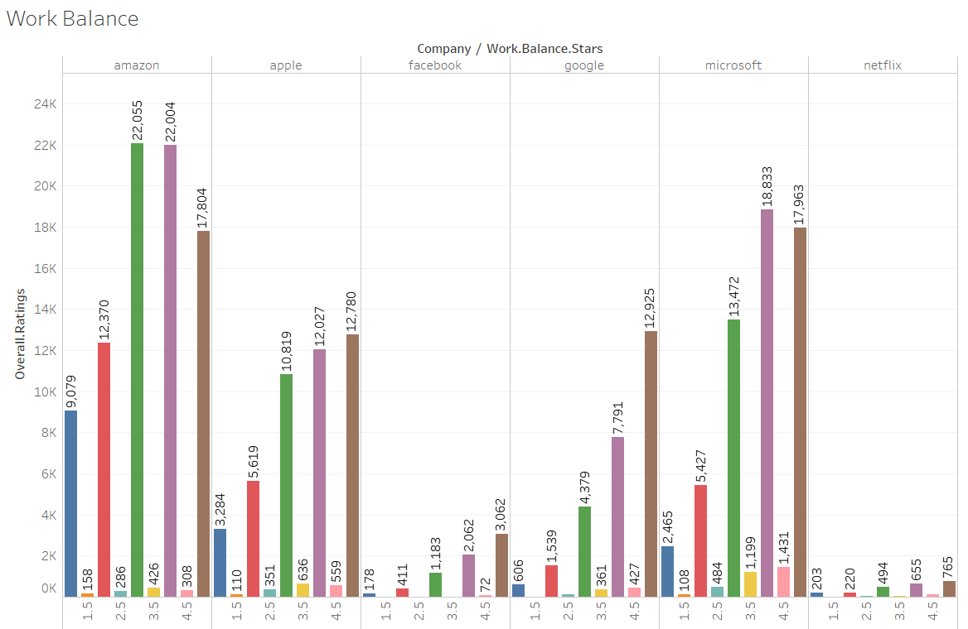
Selecting the company with work Balance by employee ratings

Slide 25
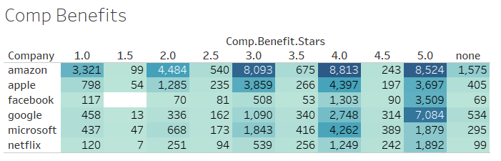
Selecting the company with comp.Benefits based on employee ratings

Slide 26
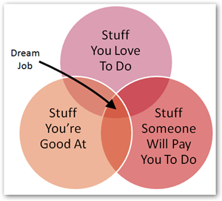
Dream Job
Analysis and visualization on the factors of Comp.Benefits,work balance,culture values,Sr management,Carrier Opportunities which make person to choose their own direction of carrier path in there respective fields and interests according to the ratings of employees

Slide 27


Slide 28


